Slide 2
Regular Expressions

Slide 3
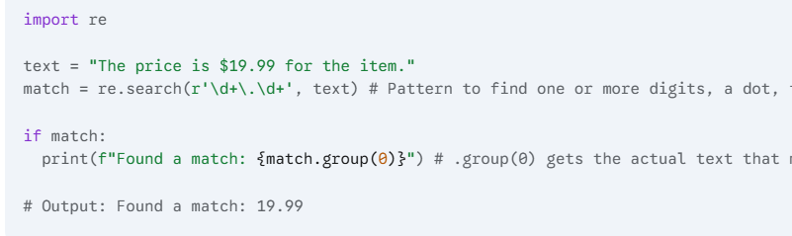
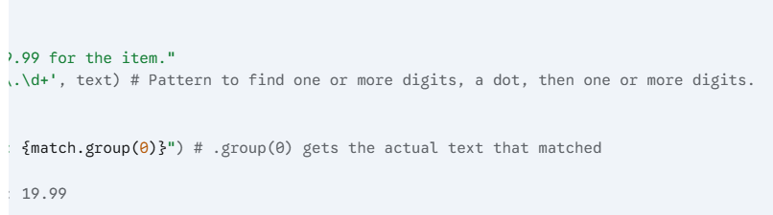
Regular Expressions
Regular Expressions, often called Regex, are a powerful mini-language for finding and manipulating patterns within text. Think of it as a supercharged "Find & Replace" that can handle complex rules. To use it in Python, you first need to import re.
Core Functions
1. re.search(): Find the First Match
This function scans a string and looks for the first location where the pattern matches. If it finds a match, it returns a special "match object"; otherwise, it returns None.

Slide 4
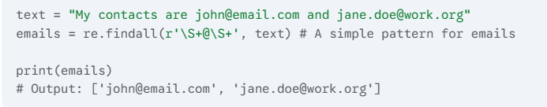
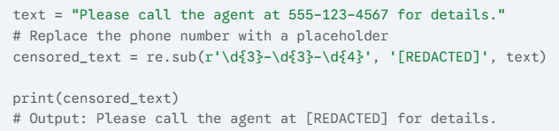
Regular Expressions
2. re.findall(): Find All Matches
This is one of the most useful functions. It finds all non-overlapping matches of the pattern in a string and returns them as a simple list of strings.
3. re.sub(): Find and Replace
This function replaces all occurrences of a pattern with a specified string.

Slide 5
Regular Expressions
2. re.findall(): Find All Matches
This is one of the most useful functions. It finds all non-overlapping matches of the pattern in a string and returns them as a simple list of strings.
3. re.sub(): Find and Replace
This function replaces all occurrences of a pattern with a specified string.

Slide 6
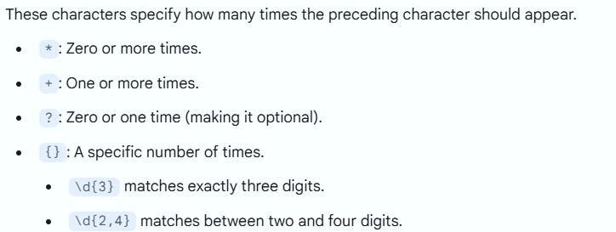
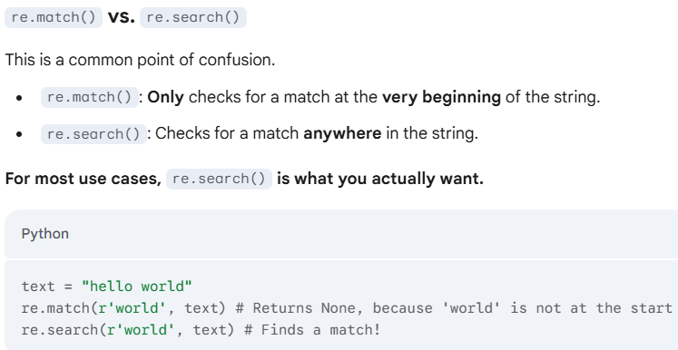
Regular Expressions
Quantifiers (How Many Times?)

Slide 7
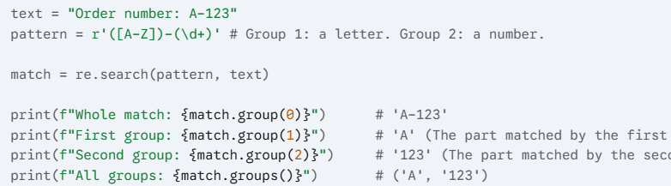
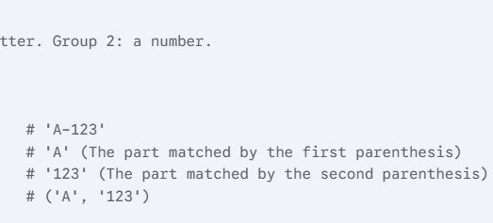
Regular Expressions
Grouping with Parentheses ()
Parentheses do two things: they group parts of a pattern together, and they "capture" the text that matches inside them. This is extremely useful for extracting specific pieces of information.

Slide 8
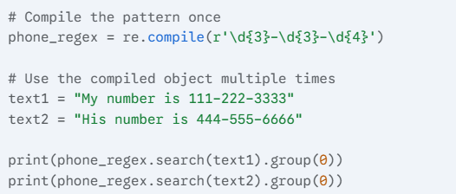
Regular Expressions
Pre-compiling Patterns for Performance
If you plan to use the same Regex pattern many times (like inside a large loop), you can "compile" it first. This makes it slightly more efficient.

